Slide 1
Loyola University Chicago
Stritch School of Medicine
Office of Student Affairs/
Office of Medical Education
CLASS OF 2026
INTRO to M4 YEAR SERIES
Session #1-
Overview, Scheduling, Planning

Slide 2
What most M3s what to know now:
What is the M4 calendar
Track information
Lottery information
How do I organize my calendar/year
Electives/aways
When should I take Step 2

Slide 3
Today’s Agenda
Fourth Year Academic Overview
Clerkship Track System and Calendar
Required clerkships
Elective requirements
VSLO registration
USMLE Step 2 requirements & timing
Lottery Process
Residency Planning: Future Meetings

Slide 4
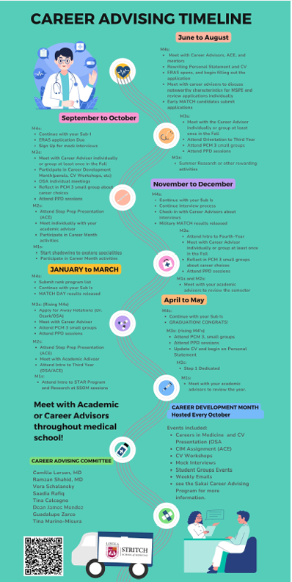
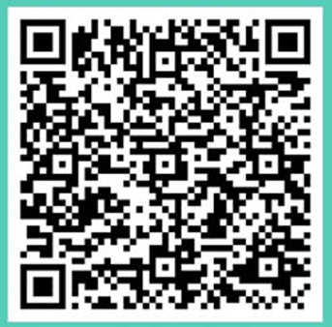
Notes:
Reminder about the Career Advising Timeline which was introduced last month at the PPD session which has a 4-year guide divided by months to keep you on track towards residency.

Slide 5
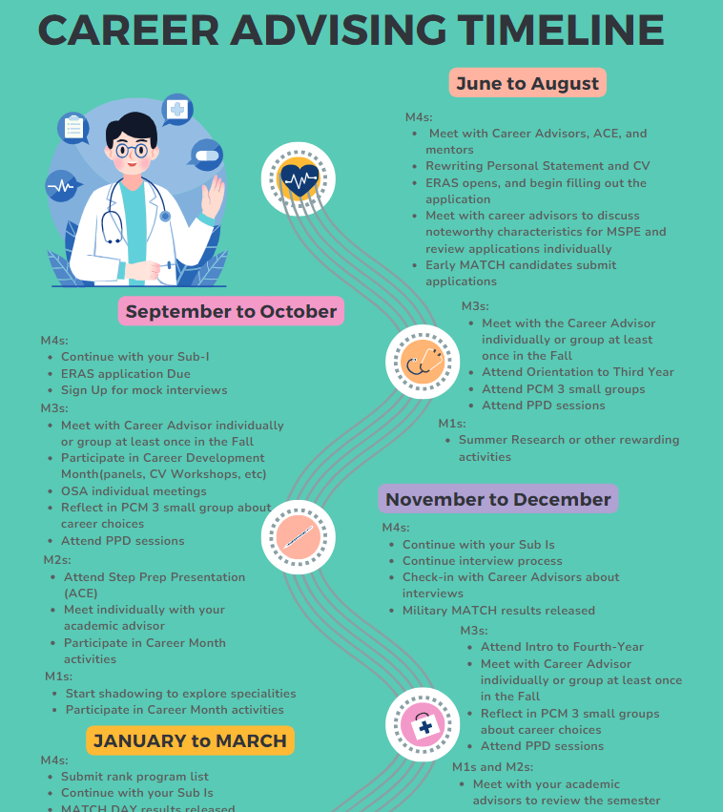
Notes:
As promised, today is the first of the Intro to M4 year talks.

Slide 6
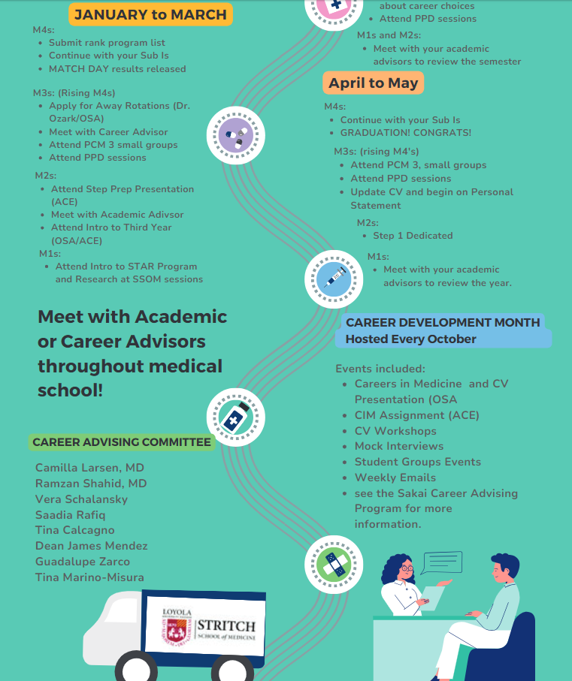
Notes:
Coming up, from Jan to May, there are also ‘to-do’s’ and programmatic offerings.

Slide 7
M4 Clerkship Track System – Class of 2026
Notes:
There are 11 tracks available in your M4 year.

Slide 8
Calendar details:
Year 4 start date:
  First period block starts Monday, May 5th, 2025 (May = Period “8B”).
Breaks:
  Summer: End of July/Early August (7/26/25 - 8/3/25)
  Winter: End of Fall Semester (12/20/25 - 1/4/26)
Match Day and Graduation dates are tentative.
  Match Day tentatively March 20th, 2026
  Graduation tentatively either on Sat. May 9th or 16th, 2026
    Commencement announced by LUC Fall 2025

Slide 9
Fourth Year
Overview of Requirements
12 weeks of core clerkships:
  Emergency Medicine, Sub-I Wards, Sub-I ICU
4 weeks required PCM-4 course (Nov or Dec)
2 weeks required Transition to Residency Course (TTR) (Offered in Feb, March or April in the first 2 weeks.)
22 weeks of elective credit required for graduation
  30 weeks elective time available in M4 year for on-track students
  Must complete at least 12 weeks of clinical electives in M4 year
  Must complete at least 12 weeks of full-time coursework in final semester (full-time required clerkships or elective courses)
Bioethics Requirements
  4 Ethics Grand Rounds and a paper
USMLE Step 2 CK

Slide 10
Your M4 Year-
Readiness for Residency
Mix of required rotations and elective opportunities
Required:
  Sub-Intern Ward
  Sub-Intern ICU
  Emergency Medicine
  PCM-4 in Nov or Dec
  Transition to Residency Course 2 weeks
  22 Elective Credits (+/- 2 from M1-2, 4 from M3)

Slide 11
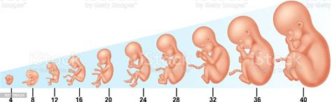

How long are the required elements of your M4 year?
40 weeks!
What takes 40 weeks?

Slide 12
Fourth Year Requirements
12 weeks of core clerkships (EM, Sub-I ICU, Sub-I Ward)
4 weeks PCM-4
2 weeks TTR Course
---------------
18 weeks out of 48 calendar weeks
22 weeks of electives for graduation
  (you may already have up to 6 weeks)
Bioethics Requirements
USMLE Step 2
Discretionary Time available
Must complete at least 12 weeks of full-time coursework in final semester
Must have 12 of the 22 weeks of electives be clinical electives

Slide 13
Readiness for Residency:
M4 Core Rotations
3 Core Clerkships:
  Sub-Intern Wards
  Sub-Intern ICU
  Emergency Medicine

Slide 14
Purpose of Required Clinical Rotations:
Sub-Internships and EM
Sub-Is:
  Focus on skills and attitudes necessary to care for hospitalized and critically ill patients
  Assuming the responsibilities of the PGY1 resident
    6 days/week, limited extra days off
    Writing orders/making management decisions
  Multiple wards/ICUs to meet needs
EM
  Triage/stabilize/manage acutely ill, undifferentiated patients
  Rotate among 3 different settings (University/Community/VA)
This 4th year exposure is a strength of our school, a benefit for residency prep, and an advantage during interviews.
Notes:
Some students wonder why there are rotation requirements in M4 year.

Slide 15
Required Rotation:
Patient-Centered Medicine-4
Offered in November or December
Asynchronous curricula allowing time for interviewing
  Schedule most interviews during this month
Can swap November and December only if no required rotation in opposite month
Online, with 1 Live Zoom session
The course is pass/fail/meets with concern

Slide 16
Required Course:
Transition to Residency (TTR)
2-week high yield course covering essential topics for intern year
First week- general topics for all interns
Second week- specialty specific training
Residency programs like this/increasingly expecting this experience of graduates
Tracks have the TTR course in first 2 weeks of Feb/Mar/Apr
  2nd week can be E(lective) or DT

Slide 17
Transition to Residency (TTR)
2nd week of TTR sessions are focused toward residency-specific topics (medicine/pediatrics/surgical/anes/EM/OB)
  Adult medicine specialties can choose any TTR session
  Pediatric focused specialties should choose the TTR in Tracks: 11B (Feb) for best experience
  Surgical specialties/anesthesia/EM should choose the TTR in Tracks: 11C (Mar) or 12A(Apr) for best experience
  OB should choose the TTR in Track 11C (Apr)
  FM can decide Adult or Peds focus
  TY or Prelim year, consider Medicine or Surgery path
Switching sessions for TTR will be subject to availability (should not count on it)
It is OK if you cannot attend your specialty-specific session, still will be high-yield, just not as customized.

Slide 18
M4 year:
Readiness for Residency
Time of Formation
40 weeks to create a child. 40 weeks to prepare for your intern year.
Be thoughtful in creating your academic plan
~$67,630/12=$5,635 per month during M4 year
You are your best investment
Resources available to help advise

Slide 19
Readiness for Residency: Electives
22 weeks of electives to graduate
12 weeks need to be clinical
Electives can be taken at Loyola/Hines
Electives can be taken outside of Loyola/Hines
  AKA Audition rotations
The PPD session on January 15th will cover electives in more detail

Slide 20
January 15th
Electives
  Specific information about making an elective plan
    Which rotations
    Educational plan
Extramural/Away/Audition rotations
  VSLO is the AAMC application program for applying to many programs

Slide 21
Extramural/Away/Audition rotations
Up to 12 weeks permitted usually through another US med school
VSLO= Visiting Student Learning Opportunity
  Web-based application platform developed by the AAMC
  Greater than 3/4th of US medical schools use VSLO to process visiting student applications; the others use their own applications
ORR will be sending you VSLO information in next few weeks so you can make an account prior to Jan 15th mtg
  We will be presenting detailed information January 15th
References:
  VSLO for timeline, websites, contact person at site
Notes:
Some quick information about electives meant as an introduction

Slide 22
Discretionary Time (DT)
Any time left over after you have met requirements for graduation can be taken as Discretionary Time
  Actual amount will vary depending on student circumstance
  Off-cycle students may have little to no DT available (i.e. you may have already used this up)
Can use DT as:
  Time for Additional Elective Opportunities
    You are allowed 12 weeks in one specialty area
    You are allowed 12 weeks extramural
  For USMLE Step 2 study time
  Residency Interview time off
  For extramural calendar adjustment (other school’s calendar doesn’t match Stritch’s)
  For remediation needs
  For personal needs

Slide 23
USMLE STEP 2 CK
First attempt CK exams be taken by the end of fall semester of fourth year (by December 31, 2025)
Residency programs increasingly want proof of successful completion of Step 2 during interview process
  Majority want proof of passing before ranking candidates (i.e. score needed by mid-January 2026)
  Many want score to offer interview (i.e. score needed by late September)
USMLE Step 2 CK must be PASSED to graduate. If a 2nd attempt is needed, scores must be received at least two months prior to graduation (mid-March 2026).
Scores reported approximately 2-3 weeks after test date.

Slide 24
What to do now:
Look through the track calendar
Think about any special circumstance you may have
  Do you have to repeat or make up a clerkship? Then Tracks with “E” in the beginning is what you will need.
  Are you going into EM? You will want tracks with EM in June/July
    Not offered in May, if you don’t get your preferred track, switches happen
When are you going to take Step 2?
  Ideally post a score before ERAS/Residency apps
    Last week in September is usual date of app release

Slide 25
M4 Clerkship Track System – Class of 2026
Notes:
There are 11 tracks available in your M4 year.

Slide 26
What else to do now:
Meet with your Career Advisor about any specific/recommended needs for your specialty
  How many away rotations required, when to do them
  Do you need a home rotation before an away
  Your advising requirement has 2 formal meetings needed: 1st and 2nd semester. See Sakai.
When does your specialty interview typically?
  Avoid required rotations during that time
    PCM4 is designed to allow interviews
    You can take DT during an “E” slot on track

Slide 27
FAQ:
If you still have to sit for Step 1:
  Still participate in Lottery, but if you are significantly off-cycle or do not pass- you will be given a custom track based on availability.
Switching req rotations can happen, but don’t base a decision on it.
PCM 4 can be taken in Nov or Dec
  Switching OK if opposite month has “E”
Only 3 tracks have a required rotation in November.
  If your specialty interviews ONLY in November, you should NOT choose that track.
Try to choose a track that has your specialty for TTR (ideal but not required)

Slide 28
Next week:
Handout emailed
Clerkship Track System and its Policies
Information about computer generated Lottery Numbers
Information about Fourth Year Calendar
VSLO information
Timeline for Elective Registration Calendar
Notes:
Our attempt is not to overwhelm you today, but to provide an overview of the next few months and give you the information you need at the time you need it.

Slide 29
PPD Future Sessions:
PPD January 15th
  Electives: Educational plan and registration process
  More about Away Rotations
  Sub-I possibility at outside program
PPD February 12th
  Personal Statement, LORs, CVs
  Capstone OSCE exercise
  Timeline for M4 year tasks

Slide 30
Future Sessions:
(last) PPD April 9th
  MSPE
  Residency Application Process
OSA will also be offering additional informational sessions in M3 and M4 years
ACE/Career Advising has additional offerings during your M4 year

Slide 31
Online Resources
Loyola SSOM Elective Catalog: https://www.luc.edu/stritch/regrec/electivecatalog/coursecatalog/
AAMC Extramural Elective Compendium: https://services.aamc.org/eec/students/index.cfm
USMLE STEP 2 info: http://www.usmle.org/step-2-ck/
Visiting Student Learning Opportunities: https://vslo.aamc.org/vslo

Slide 32
Questions?
Reminder that these slides are available on Advising Sakai under PPD session and will be on Registrar website
This session was recorded

